Slide 1




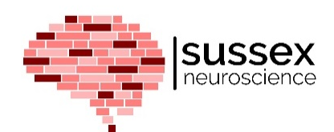
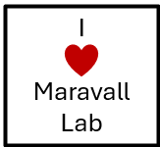

Machine Learning for Neuroscience
Prediction and Learning

Slide 2
Recap
We have looked at different datasets (calcium imaging, DANDI, etc…)
We learned about the different datatypes (Boolean, integer, float, string)
We learned the different types of dimensionality reduction (PCA, T-SNE, UMAP)
We learned about VAEs

Slide 3
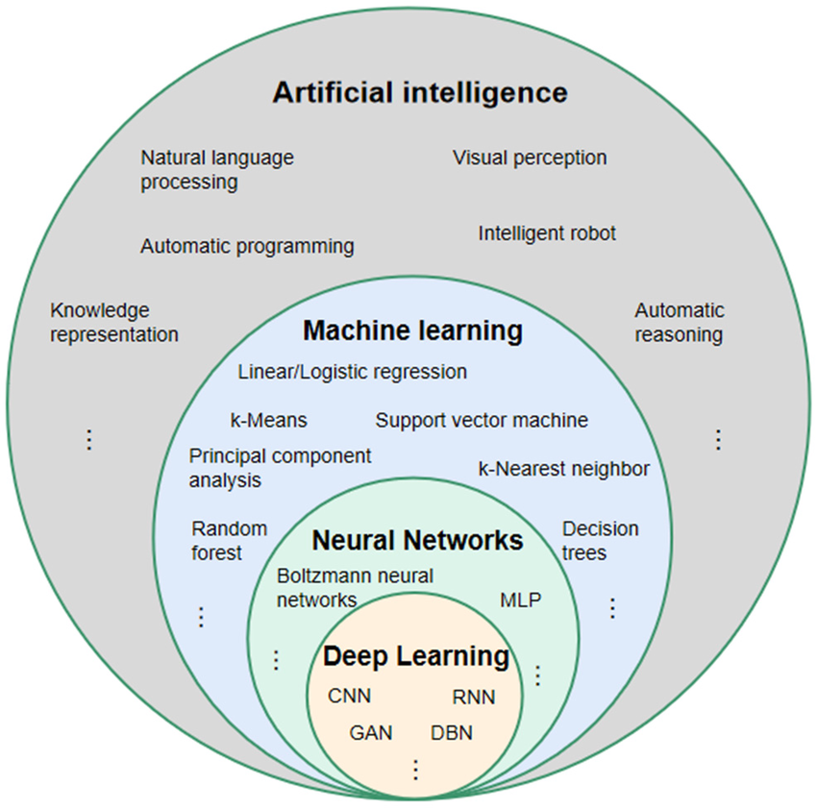
Contents

Slide 4
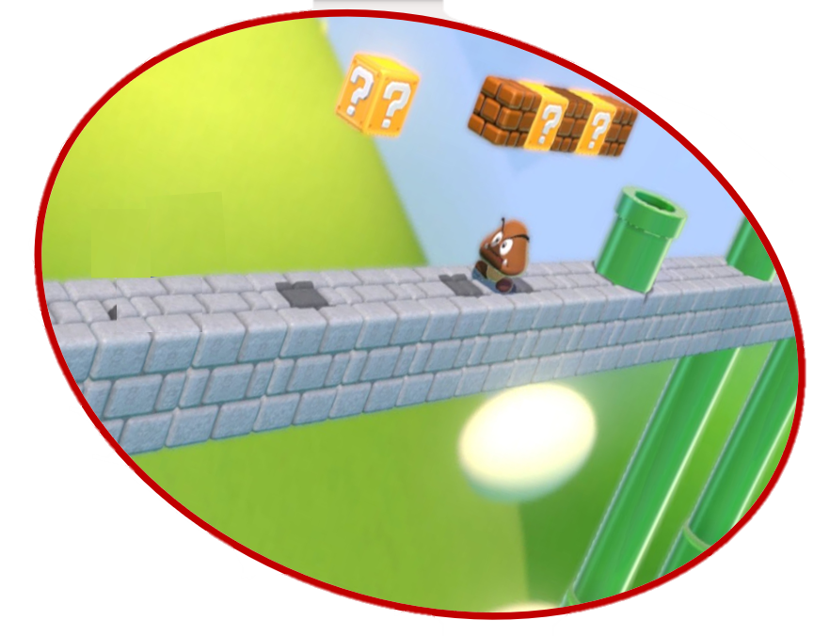

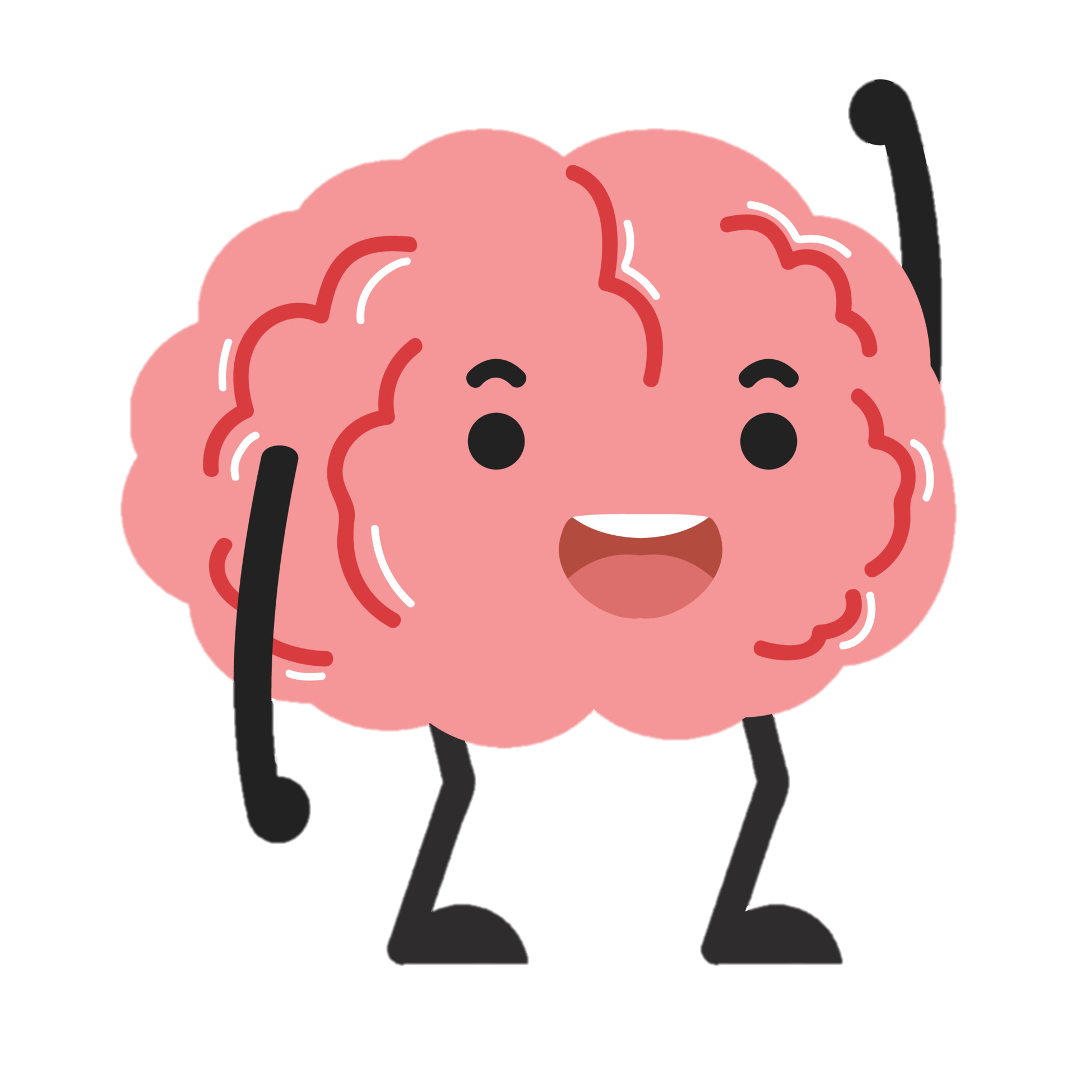
Why prediction is important for us
We have a tendency to just think of the brain in isolation
Notes:
Leaving fruit on field example

Slide 5
Why prediction is important for us
But the brain is embodied
Notes:
Leaving fruit on field example

Slide 6
And embedded in an environment
Notes:
Leaving fruit on field example

Slide 7

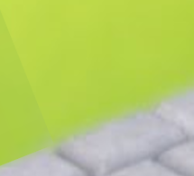

Slide 8



Slide 10
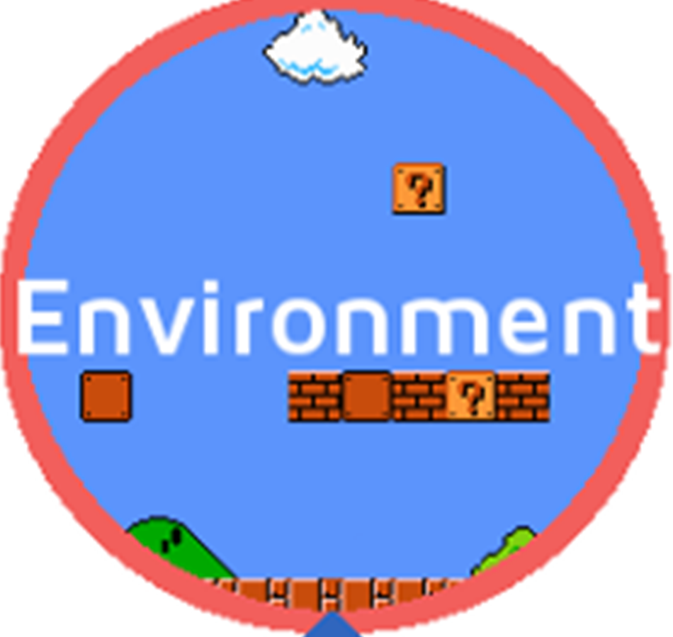

Why prediction is important for us
Input: information
Predict
what is coming next
Output: Action
Notes:
Leaving fruit on field example

Slide 11
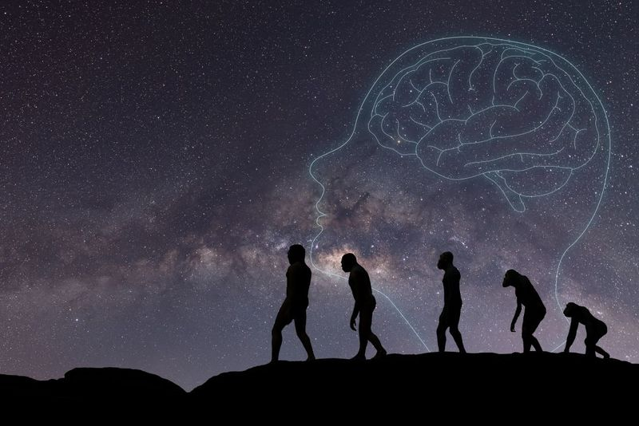
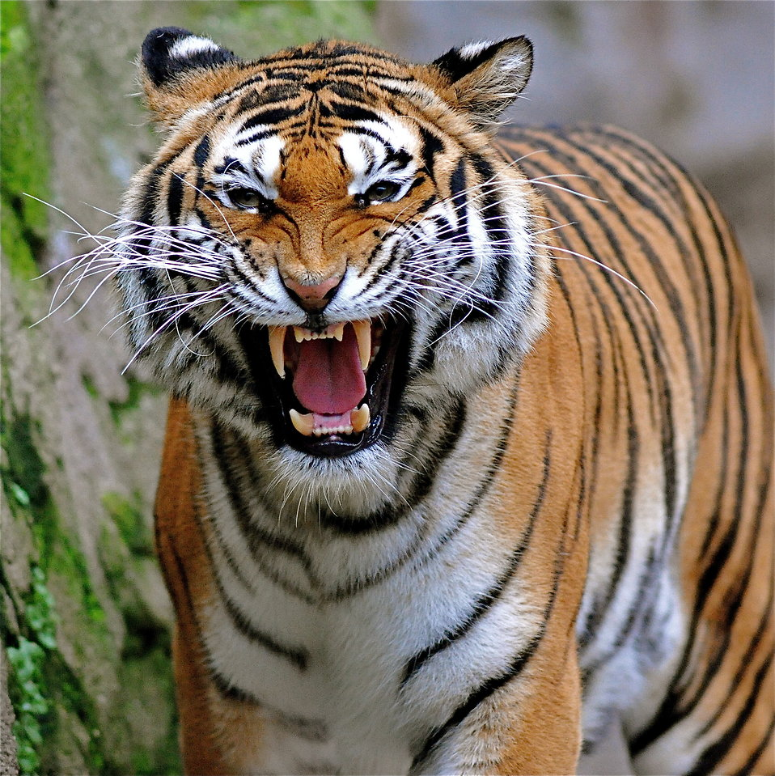

The brain is designed for pattern recognition
Pattern recognition helped our ancestors survive by allowing them to predict and respond to environmental changes, such as weather patterns or animal behaviours:
Dark clouds + intense wind ⇒ very likely rain ⇒ seek repair
Tiger growling and assuming an aggressive stance ⇒ likely going to attack ⇒ run away

Slide 12
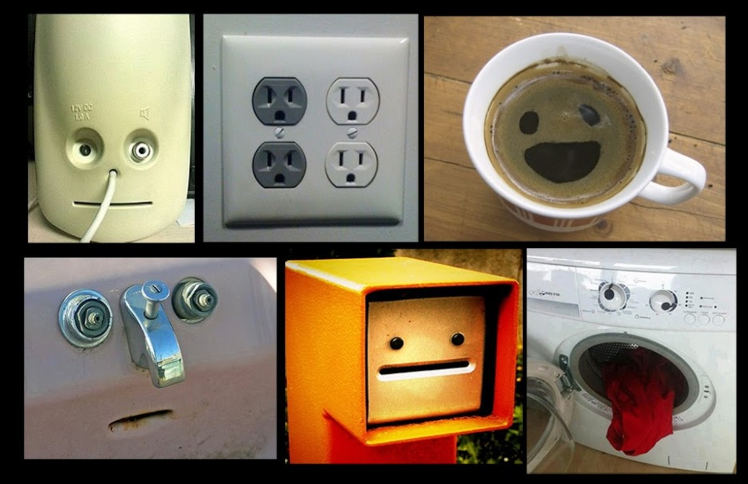

Patterns are how we make sense of the world
Patterns are all around us and we recognise them, whether explicitly or implicitly.
This is so totally Jazz
We recognise patterns in music (even if we cannot really recognise what they are exactly)
We recognise facial patterns in objects

Slide 13
Pattern recognition is crucial for prediction
Computers can identify patterns that we cannot identify

Slide 14
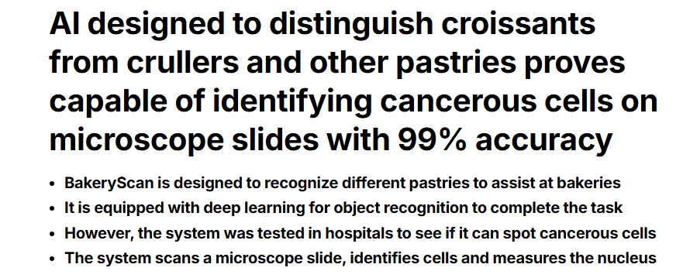
Enters the digital age

Slide 15
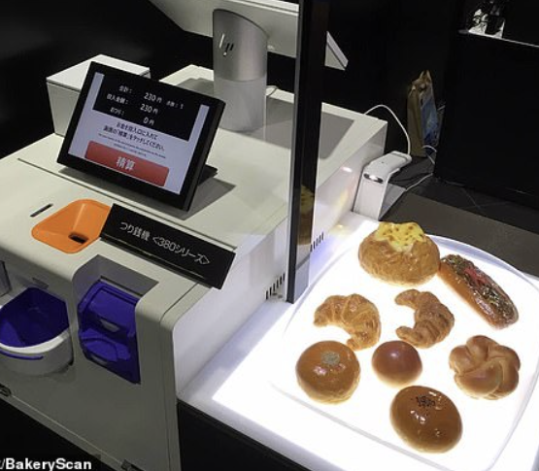
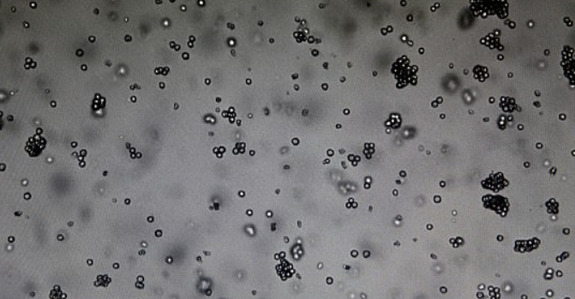
The algorithm used to recognise the types of bakery items on a tray was repurposed to recognise types of malignant cancerous cells from the benignant

Slide 16
Imagine all the things we can achieve in neuroscience once we master such powerful tools

Slide 17
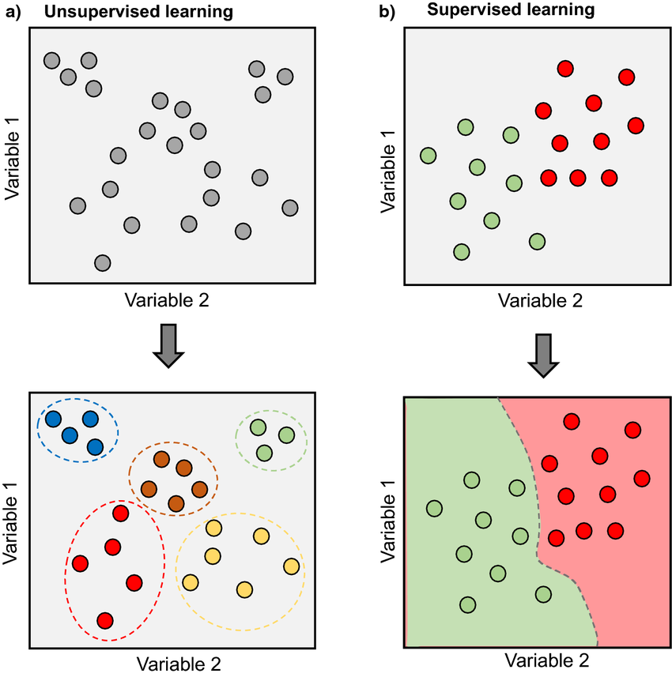
Types of learning
Unsupervised
Algorithms learn patterns exclusively from unlabelled
Used for specific algorithms such as clustering, dimensionality reduction, and association
Supervised
You have data that is labelled
Typically used in most ML problems
Requires gathering of large datasets

Slide 18
Types of learning
Unsupervised
Algorithms learn patterns exclusively from unlabelled
Used for specific algorithms such as clustering, dimensionality reduction, and association
Supervised
You have data that is labelled
Typically used in most ML problems
Requires gathering of large datasets

Slide 19


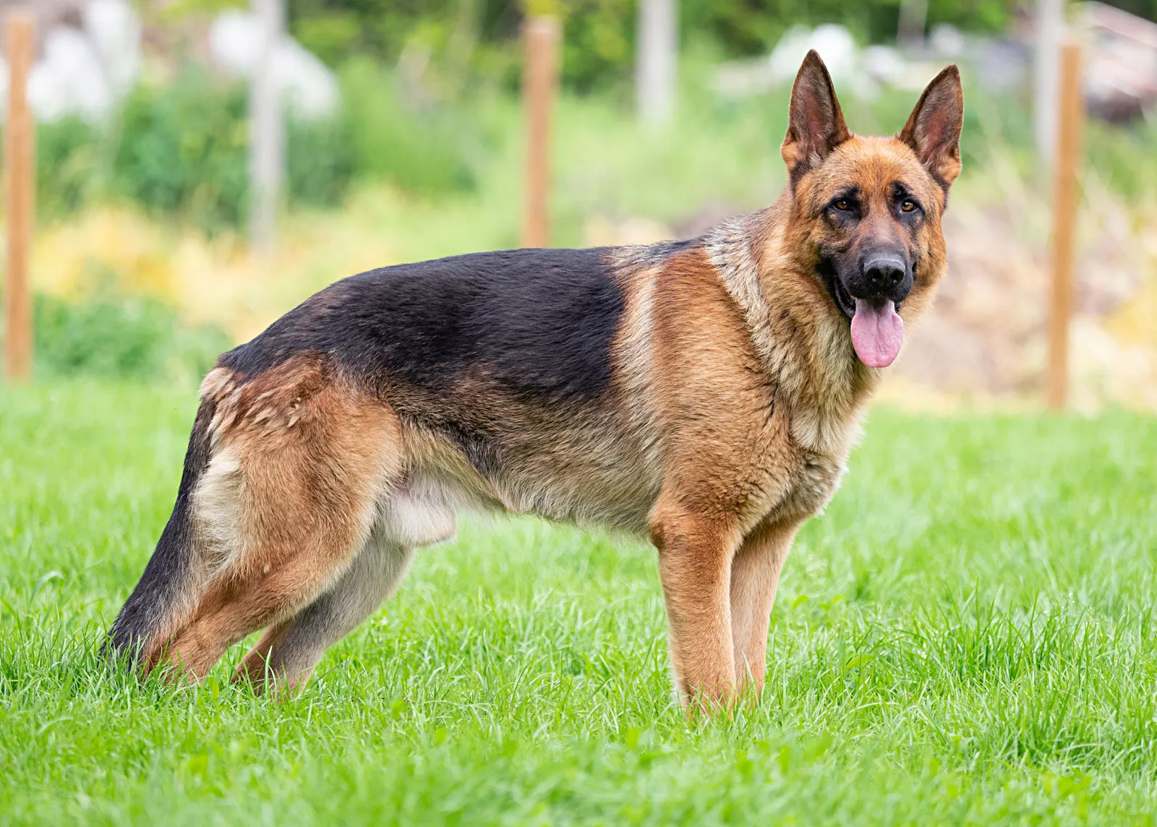



Supervised example
We have our data (known as X)
Notes:
Cats is an example, can be anything

Slide 20
Supervised example
We have our labels (known as y)
y= Class=dog
y= Class=cat

Slide 21
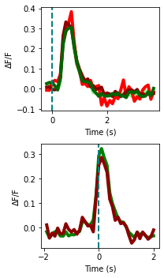
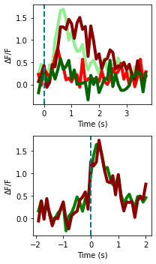
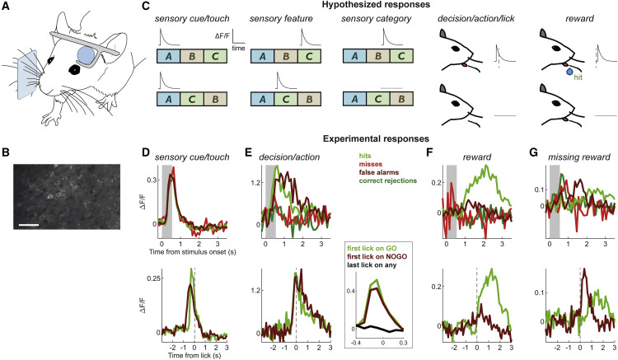
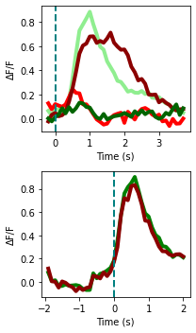
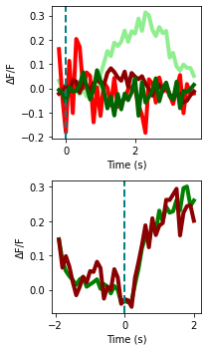
Supervised example
Our data (X)
Notes:
Cats is an example, can be anything

Slide 22
Supervised example
Our labels (y)
y = Class=sensory cue/ touch
y= Class= decision / action

Slide 23
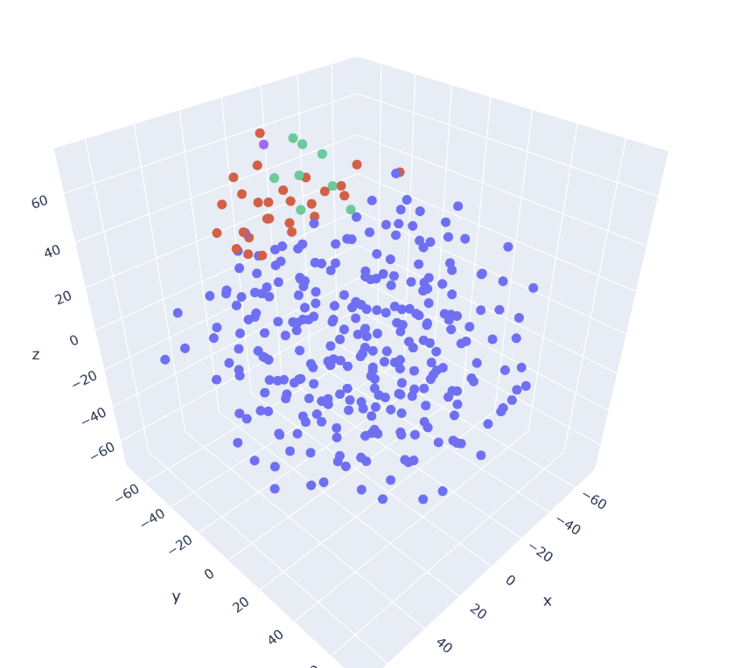
Un-supervised example
Using a clustering method known as k-means we can clearly segment the data into classes
This method does not need labelling

Slide 24
Supervised vs unsupervised
Labelling data costs time (and money)
Data needs to be high quality and relevant for unsupervised
Unsupervised is helpful when data gathering is challenging eg. labelling something you don’t always know.
Notes:
Talk about own experience labelling data

Slide 25
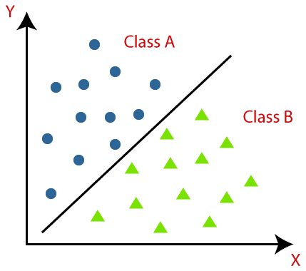
Overview of Classification
Classification is is a machine learning technique used to categorize data into distinct groups or classes. It helps us assign labels to new data points based on patterns learned from past data.

Slide 26
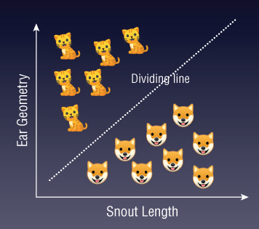

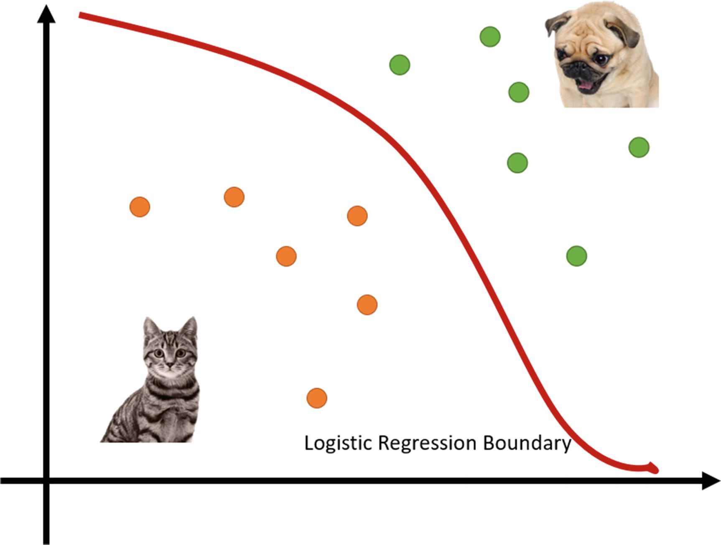
Binary Classification
Goal: find decision boundary (dividing line between classes)
Logistic Regression
SVM
Probability(Cat)
Geometrically
Probabilistically
Cat or Dog?
Features(weighted)

Slide 27
Binary Classification - SVM
Goal: find lower-dimensional decision boundary - hyperplanes
-> Separates classes in the feature space
-> Cat X
Cat or Dog?

Slide 28
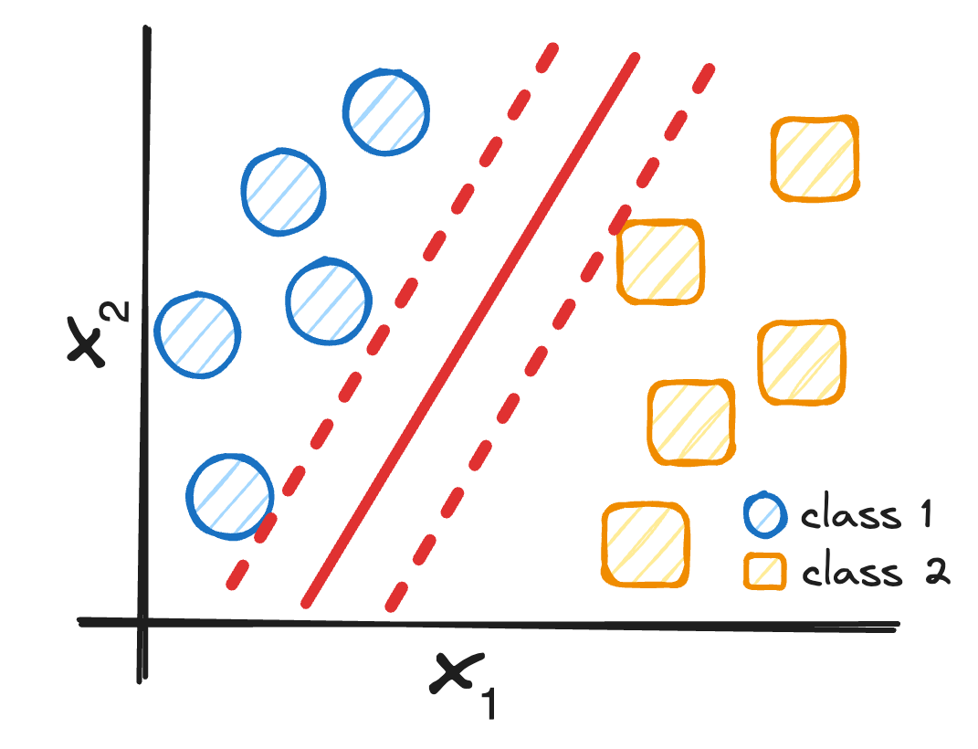
Support Vector Machine (SVM)
Goal: find hyperplane that maximizes the margin between the support vectors
w⋅x+b=0
distance
nearest points of each class

Slide 29
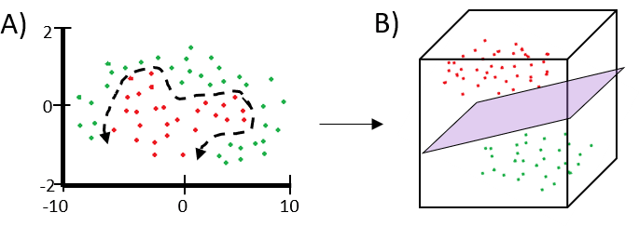
What if we have non-linearly separable data?
-> no optimal hyperplane possible!
Standard SVM fails when data is not linearly separable.
Solutions:
Soft Margin SVM: allows misclassification by changing constrain function
Kernel Trick: maps data into higher dimensional space

Slide 30
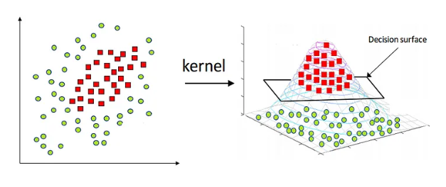
Kernel Functions
Use a kernel function to transform data into a higher-dimensional space before finding hyperplane.
Common Kernel Functions:
Linear: no transformation, standard SVM
Polynomial: curved decision boundaries
RBF (Gaussian), Sigmoid: non-linear data, complex patterns

Slide 31
More complex classification problems
Random Forest

Slide 32
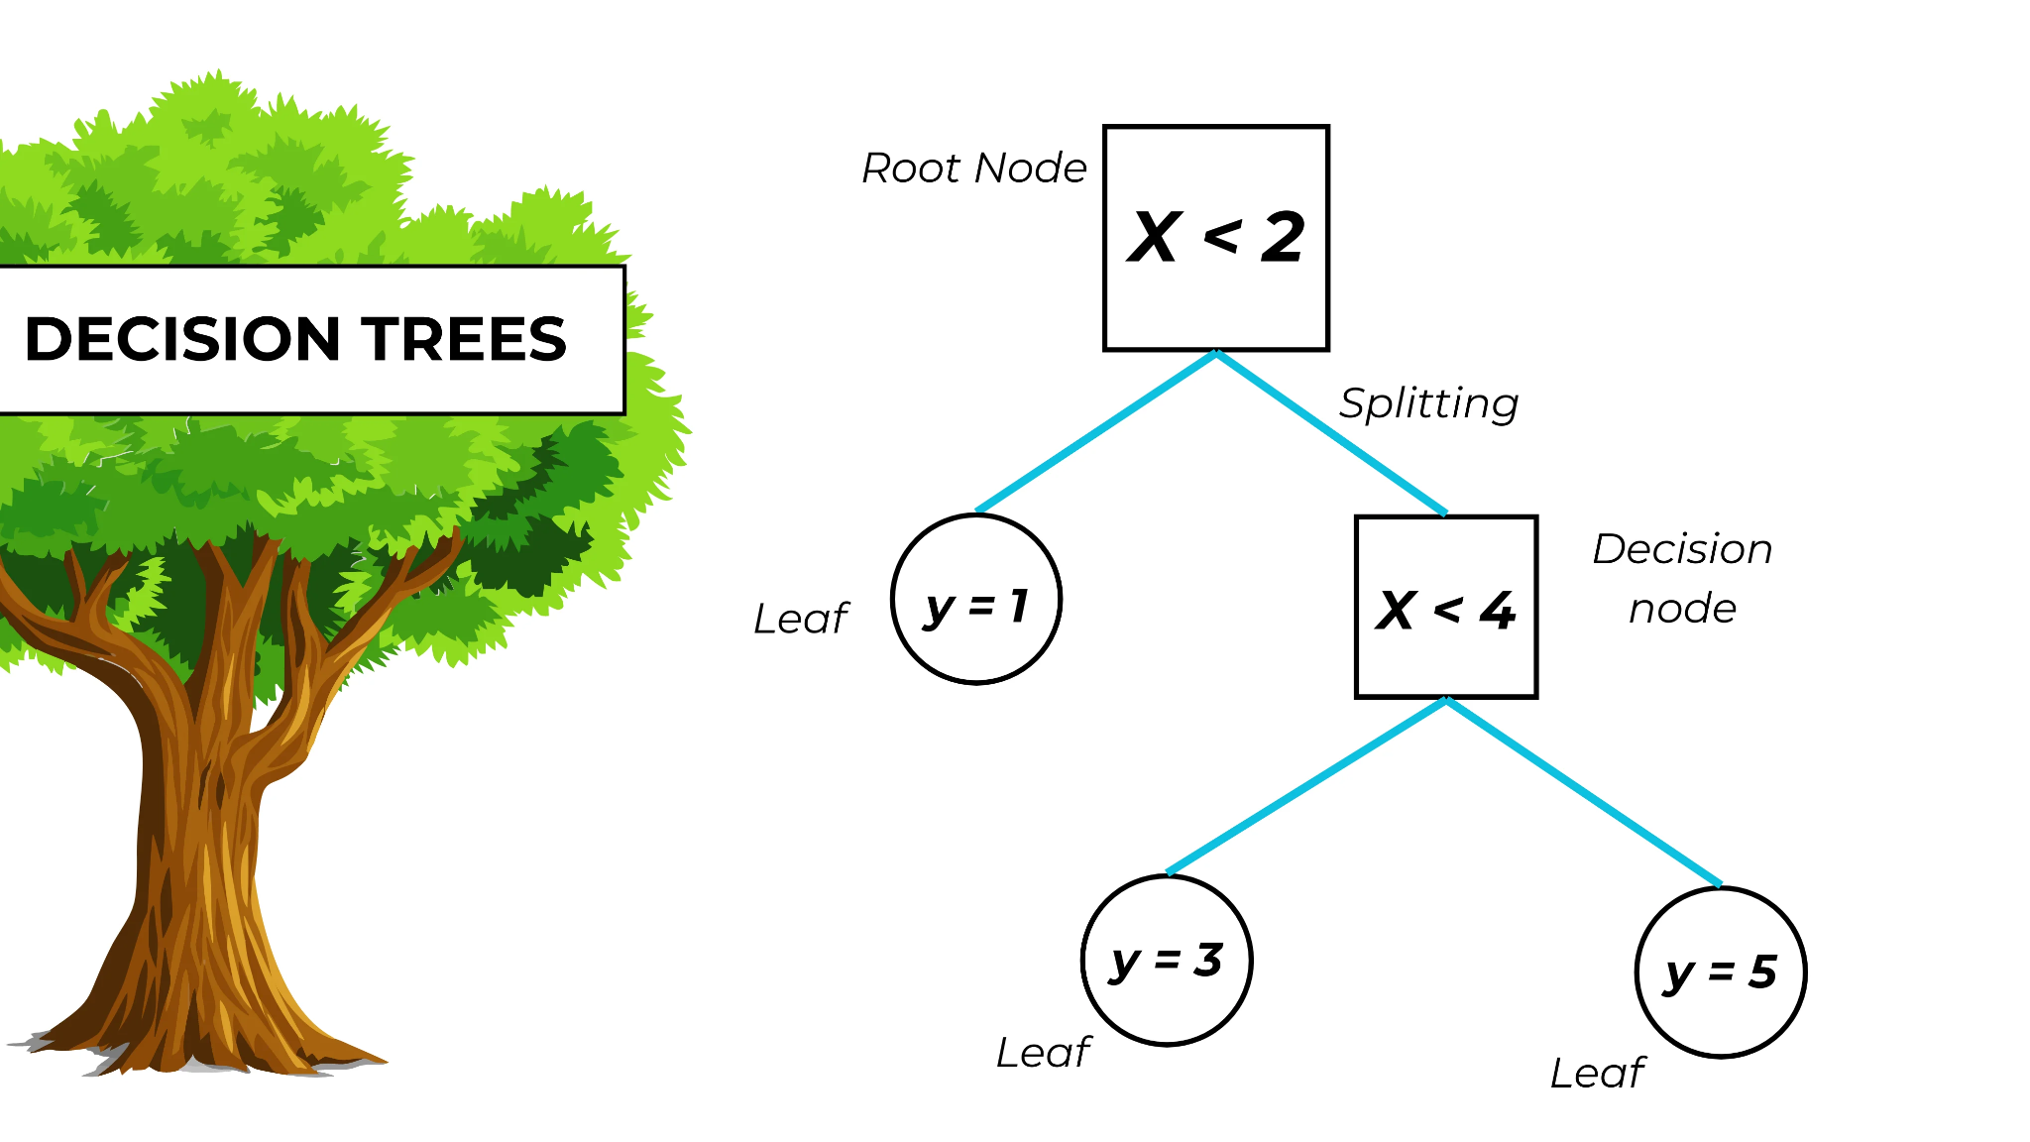
Decision Trees
Learns patterns in data by repeatedly splitting based on features, leading to a decision boundary that classifies the input data.
Root Node: Starting point
Decision Nodes: Split data based on features
Leaf Nodes: Final nodes with predictions
Output: Class label at the leaf node

Slide 33
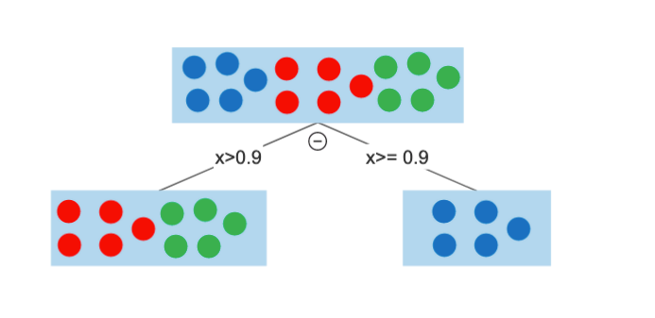
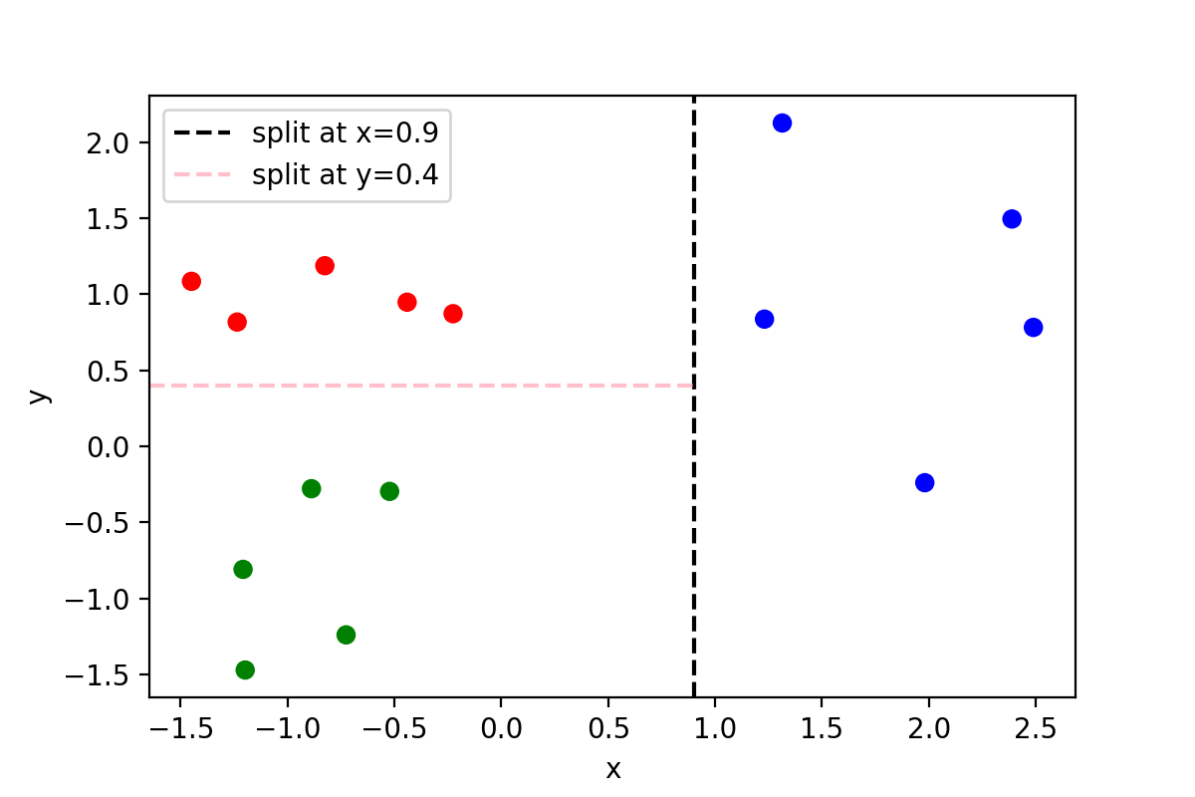
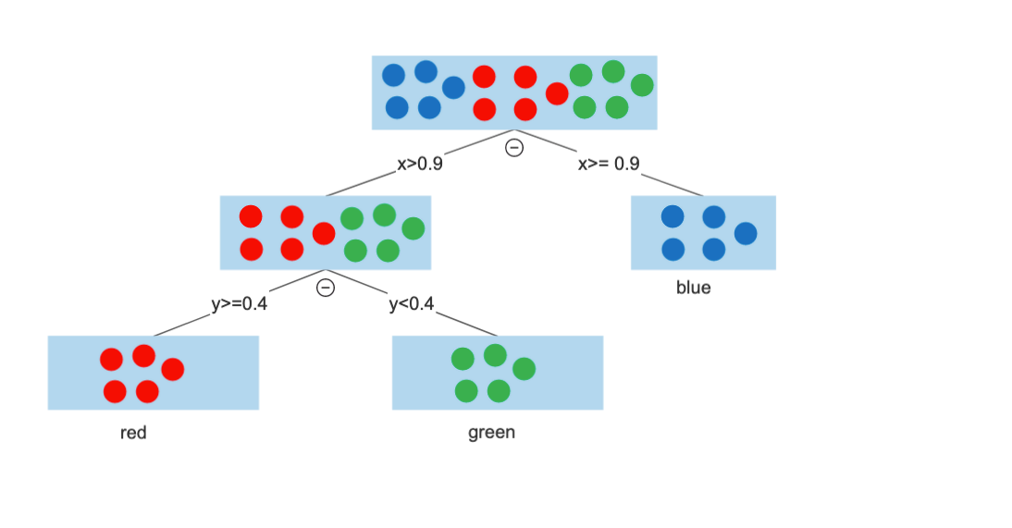
Example
1.
2.

Slide 34
Random Forest:
Ensemble of decision trees
A collection ("forest") of Decision Trees.
Each tree is trained on a random subset of the data and a random subset of features.
The forest aggregates the output of all trees
For classification: takes the majority vote.

Slide 35
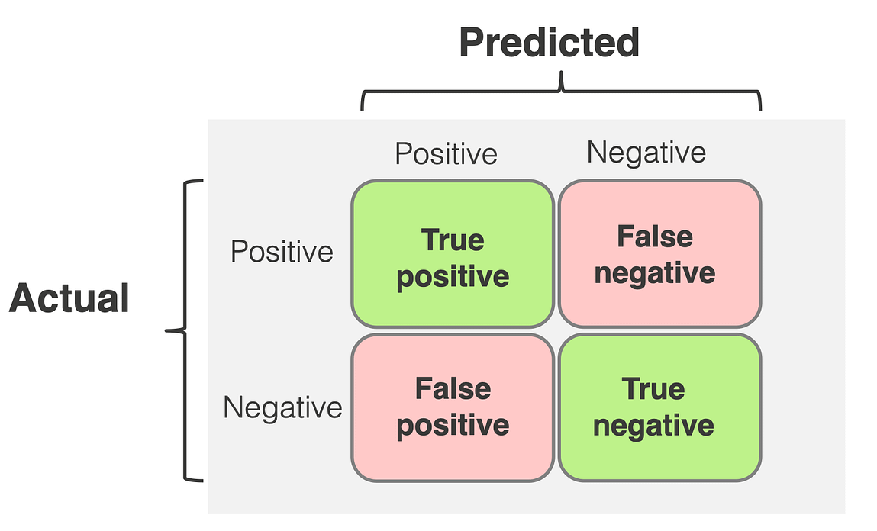
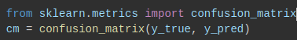
How does your classification model perform?
Accuracy: Proportion of correct predictions
Precision: Precision=TP/TP+FP
How many positive predictions are actually correct?
Recall (Sensitivity): Recall=FN/TP+FN
How many actual positives are correctly identified?
F1-Score: F1-Score=2×(Precision+Recall/Precision×Recall​)
Balances precision and recall

Slide 36
Splitting this data
Data splitting allows us to build robust models that perform well on training data and generalise effectively to new, unseen data.
Training data
This is the section of the data set we use to train the model, our model might get really good at predicting this, but that does not mean the model works well
Testing data
The data we use to test how the model performs on unseen data. This gives a good idea of model robustness.

Slide 37
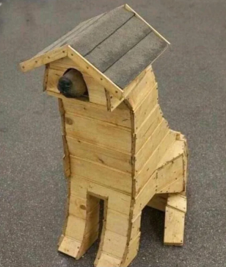
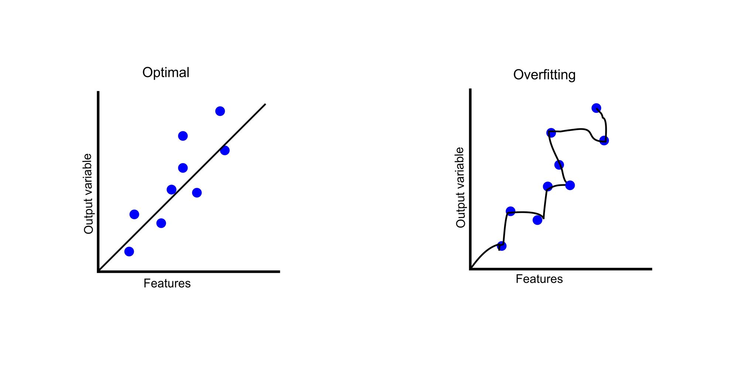
Overfitting
Overfitting occurs when a machine learning model learns the training data too well, capturing noise or random fluctuations in the data rather than the underlying patterns.

Slide 38

Under fitting
Model has not been trained enough
Data is not meaningful enough

Slide 39
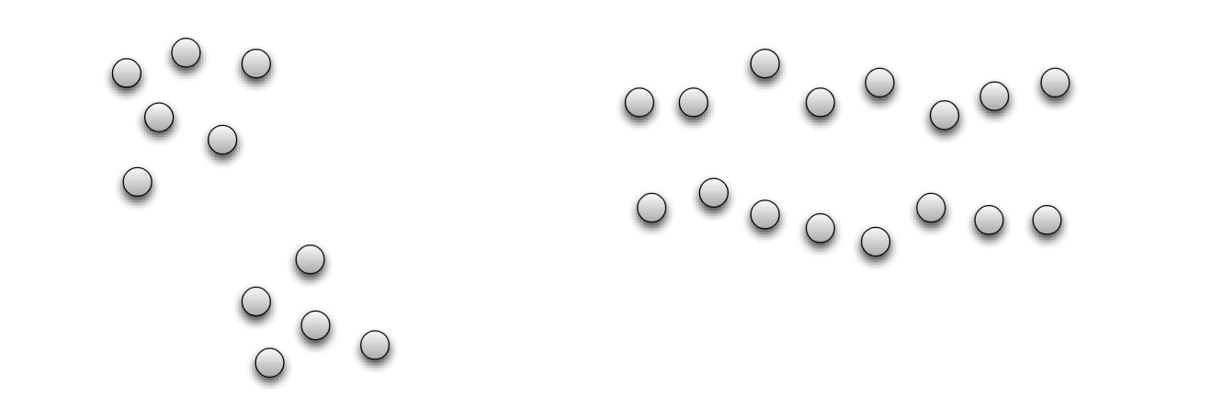
Clustering
Basic idea: group together similar instances

Slide 40
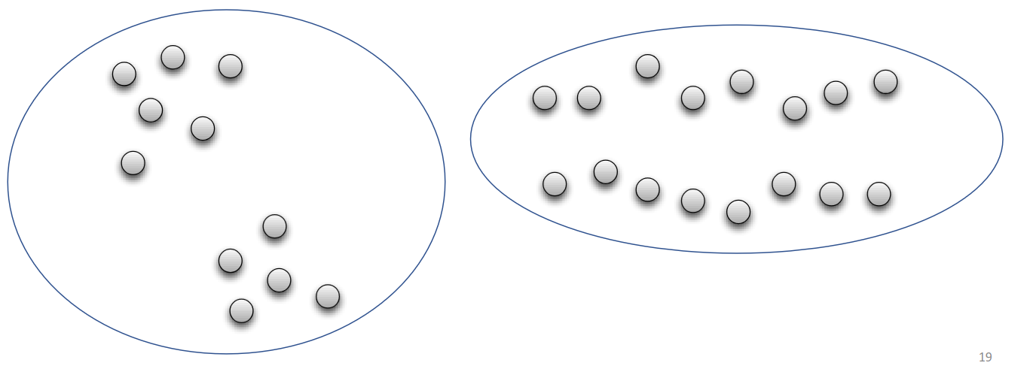
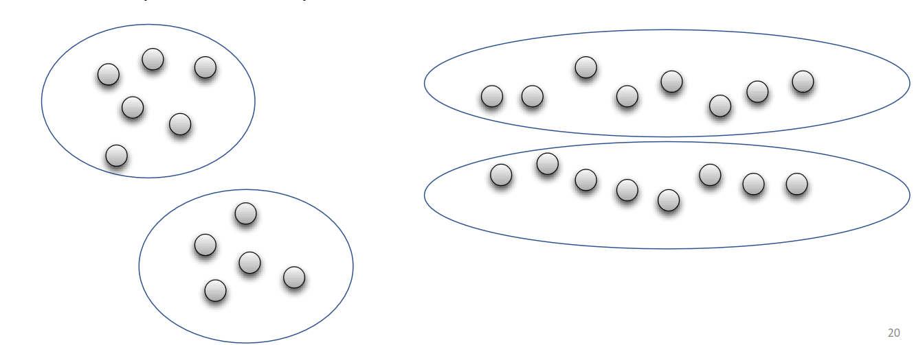
Clustering
Basic idea: group together similar instances
-> dependent on the measure of similarity (or distance) between “points” to be clustered

Slide 41
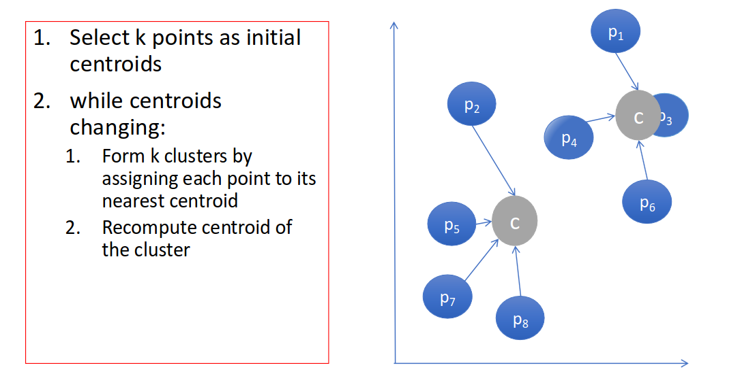
K-means Algorithm
Unsupervised: No labels or predefined categories.
Clusters: Groups of points that are more similar to each other than to those in other clusters.
Centroid: The "centre" of a cluster, calculated as the mean of all points in the cluster.

Slide 42
K-means Algorithm
In neuroscience, this is ideal for:
Grouping neurons with similar activity patterns;
Identifying states in brain imaging data;
Segmenting behavioral responses in trial data

Slide 43
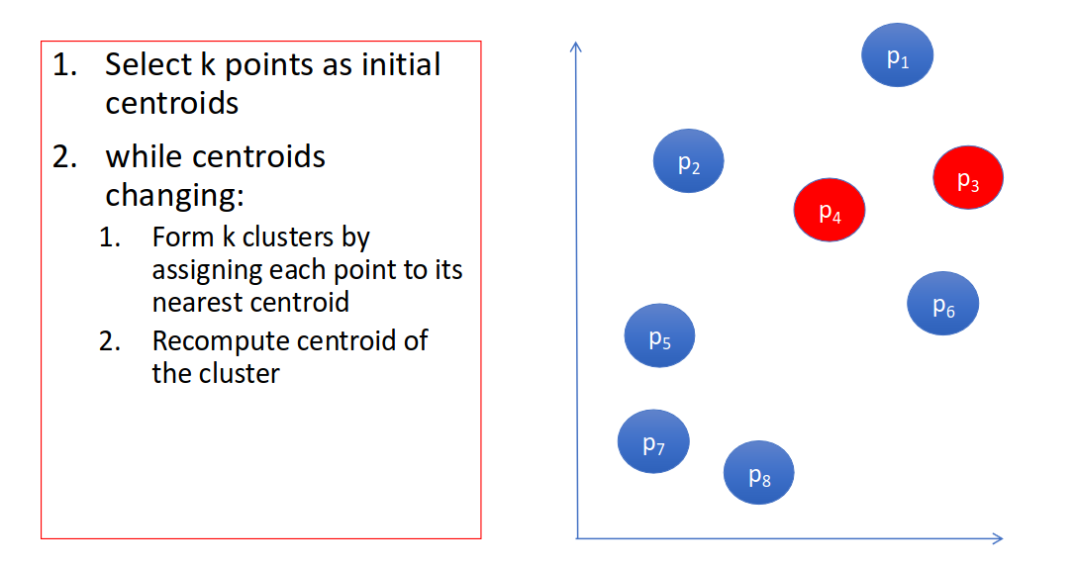
K Means Algorithm

Slide 44
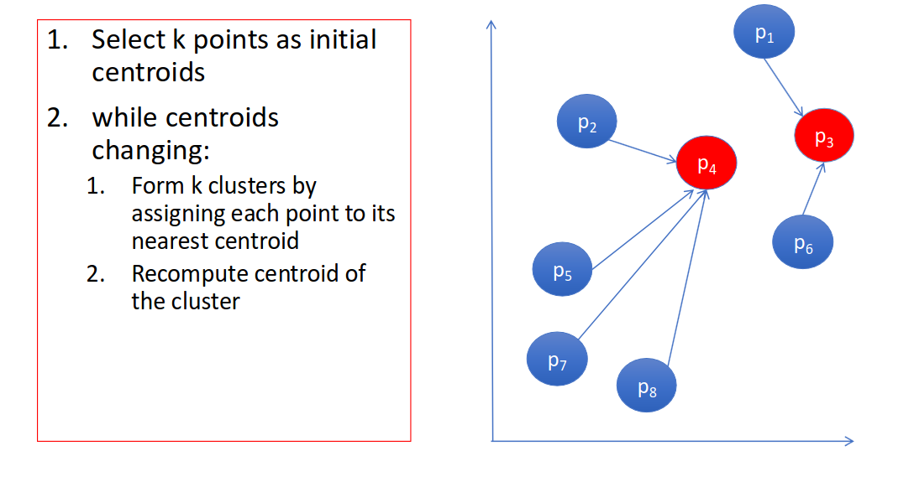
K Means Algorithm

Slide 45
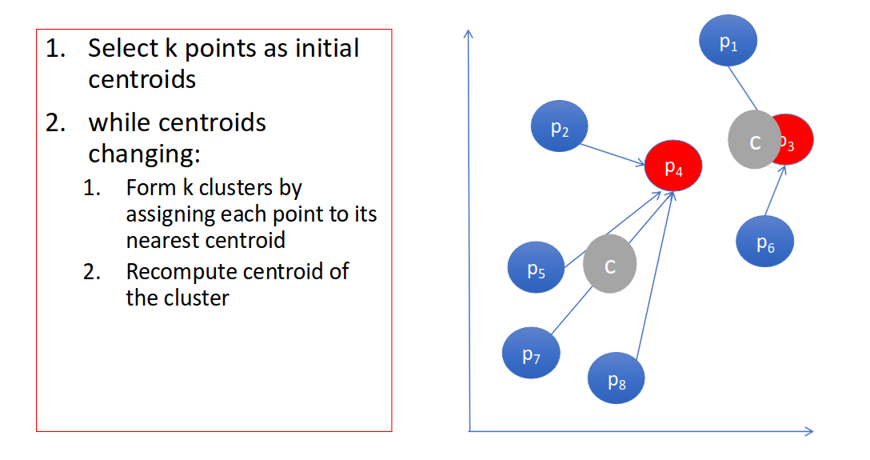
K Means Algorithm

Slide 46
K Means Algorithm

Slide 47
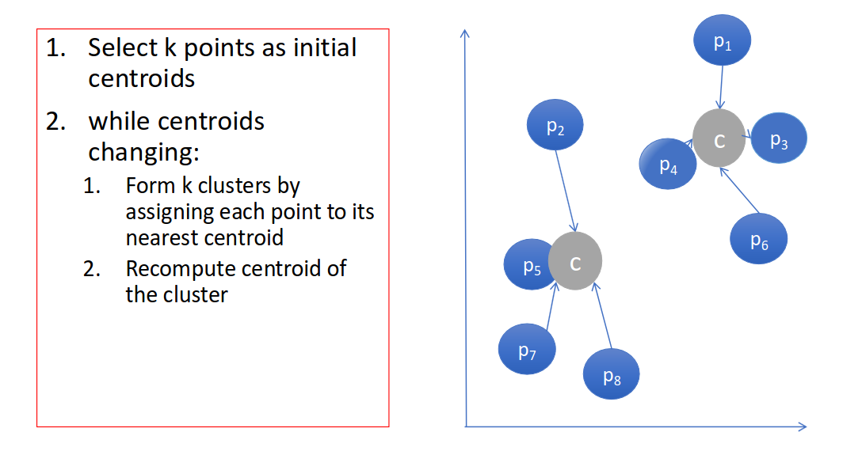
K Means Algorithm

Slide 48
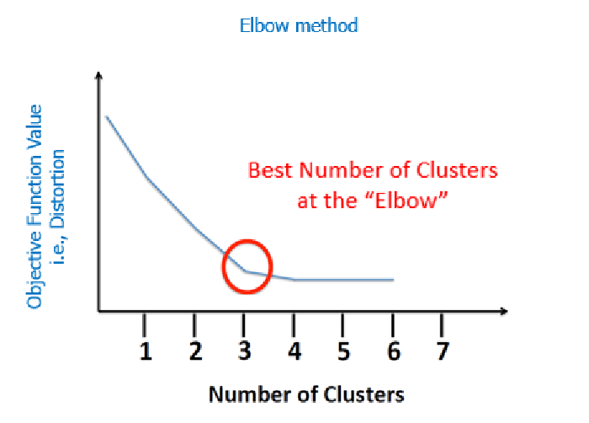
K-Means
How many clusters to choose?

Slide 49
K-Means Pros and Limitations
Pros:
fast, simple: no need to compute distances between all pairs of points; easy to implement
Limitations:
need to predefine k (the number of clusters)
may converge to suboptimal clusters (dependent on random initializations)
each point is assigned to one cluster
no hierarchical relationships (no clusters within clusters)
Alternative Clustering Methods:
Hierarchical Clustering, DBSCAN,...

Slide 50
Neural Networks

Slide 51
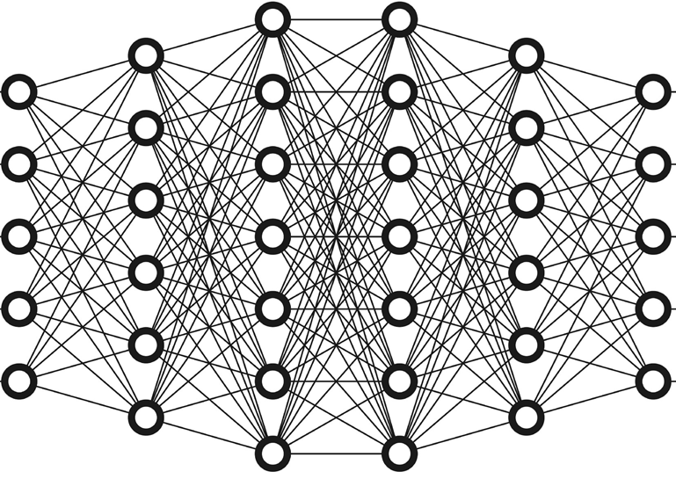
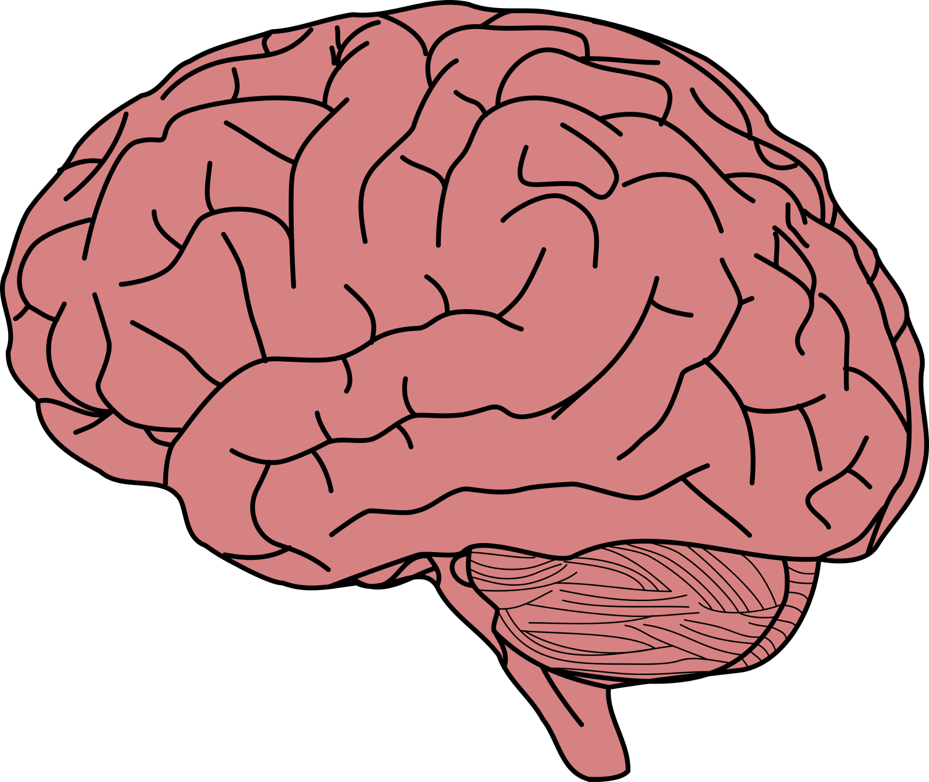
Neurons and Artificial Neural Networks
X: inputs
y: outputs

Slide 52
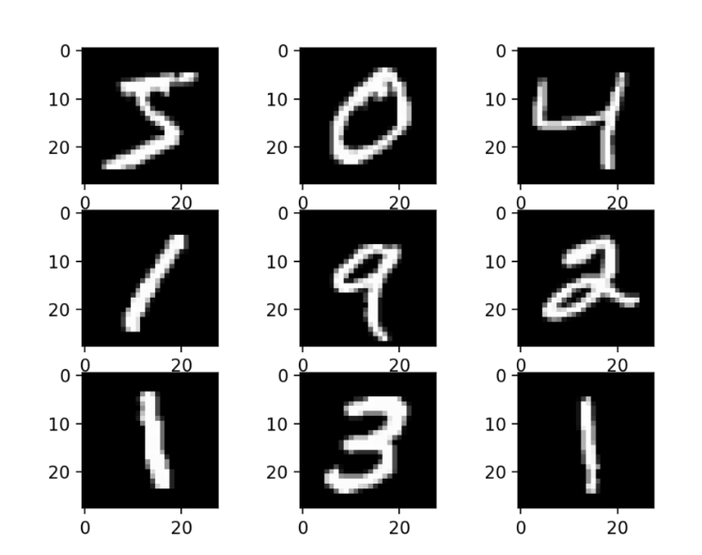
Artificial Neural Networks can be classifiers
Dataset
60,000 small square 28×28 pixel grayscale images of handwritten single digits between 0 and 9

Slide 53
Artificial Neural Networks can be classifiers
Image recognition
X:
y: 2

Slide 54
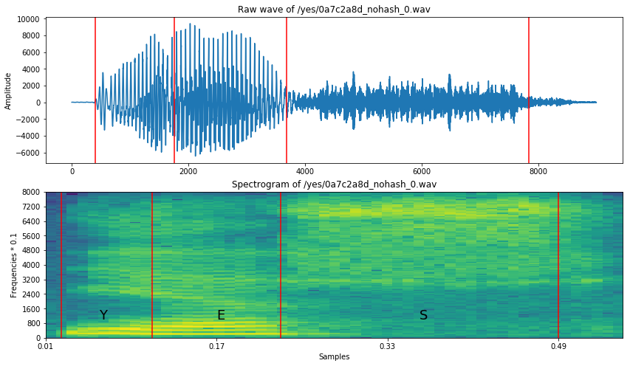
Artificial Neural Networks can be classifiers
Speech recognition
X:
y: “yes”
Spectrogram of the spoken word “yes”

Slide 55
Artificial Neural Networks
Can do countless things, including :
Natural Language Processing (NLP):
Input: Text data (e.g., a sentence or document).
Output: Processed text (e.g., sentiment score, translated text, or named entities).
Medical Diagnosis:
Input: Medical images (e.g., X-rays, MRIs) or patient data (e.g., age, symptoms).
Output: Diagnosis or probability of a condition (e.g., presence of a tumor).
Financial Services:
Input: Historical financial data (e.g., stock prices, transaction records).
Output: Predictions (e.g., future stock prices, fraud detection alerts).
Autonomous Vehicles:
Input: Sensor data (e.g., camera images, LIDAR scans).
Output: Driving actions (e.g., steering angle, acceleration, braking).
Recommendation Systems:
Input: User behaviour data (e.g., past purchases, viewing history).
Output: Recommendations (e.g., movies, products

Slide 56
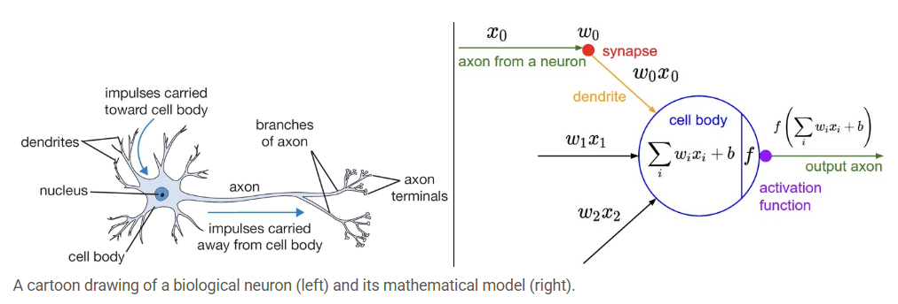
Biological vs Artificial neuron

Slide 57
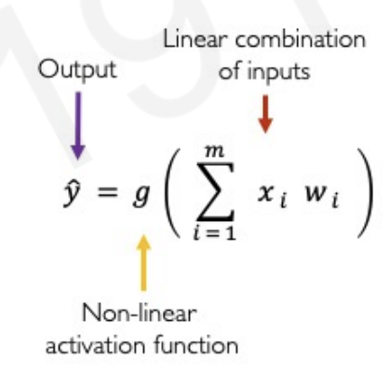

Perceptron: the singular neuron
The building block of Artificial Neural Networks
Inputs
Weights
Sum
Non-Linearity
Output

Slide 58




Perceptron: the singular neuron
Bias
Inputs
Weights
Sum
Non-Linearity
Output
The bias term is a scalar that allows us to shift left or right along our activation function

Slide 59

Perceptron: the singular neuron
Bias
Inputs
Weights
Sum
Non-Linearity
Output

Slide 60

Why do we need Activation Functions?
The purpose of activation functions is to introduce non-linearities into the network

Slide 61


Why do we need non-linearity?
Linear activation functions produce linear decisions no matter the network size
Non-linearities allow us to approximate arbitrarily complex functions

Slide 62



What types of activation functions are there and how do we pick one?
Sigmoid non-linearity squashes the numbers to range between [0,1].
Used for models where we have to predict the probability as an output
tanh non-linearity squashes the numbers to range between [-1,1]
Tanh tends to be preferred to sigmoid

Slide 63


What types of activation functions are there and how do we pick one?

Slide 64

What types of activation functions are there and how do we pick one?

Slide 65


What types of activation functions are there and how do we pick one?
f(x)=max(0,x)
ReLu (Rectified Linear Unit) activation function is zero when x < 0 and then linear with slope 1 when
x > 0
ReLu speeds up the calculations up to 6x compared to tanh
ReLU units can be fragile during training and can “die”. (i.e. neurons that never activate across the entire training dataset) if the learning rate is set too high. With a proper setting of the learning rate this is less frequently an issue.

Slide 66

What types of activation functions are there and how do we pick one?
f(x)=max(0,x)
ReLu (Rectified Linear Unit) activation function is zero when x < 0 and then linear with slope 1 when
x > 0

Slide 67


What types of activation functions are there and how do we pick one?
Leaky ReLUs are one attempt to fix the “dying ReLU” problem.
Instead of the function being zero when x < 0, a leaky ReLU will instead have a small positive slope (of 0.01, or so). That is, the function computes f(x)=1(x<0)(αx)+1(x>=0)(x) where α is a small constant.
Other solutions to the “dying ReLU” problem include ELUs (Exponential Linear Units) and PReLUs (Parametric ReLU).

Slide 68

What types of activation functions are there and how do we pick one?
Leaky ReLUs are one attempt to fix the “dying ReLU” problem.

Slide 69


What types of activation functions are there and how do we pick one?
Softmax is used when you need to classify data into more than two categories. For example, if you have a dataset with images of cats, dogs, and birds, Softmax can help determine the probability that a given image belongs to each of these classes.
It is applied after the output.

Slide 70

What types of activation functions are there and how do we pick one?

Slide 71


Perceptron: an example
1
5
-3
w₀
We have w₀ = 1 and
x₁
w₁ =5
Ʃ
y
w₂ =-3
5
-3
x₂
5
3
Inputs
Weights
Sum
Non-Linearity
Output

Slide 72







Perceptron: an example
1
w₀
(z)
z < 0
y < 0.5
x₁
w₁ =5
Ʃ
y
w₂ =-3
3
x₂
If we have an input
3
z > 0
y > 0.5
5
3
3
= g(-20) = 2.06 E-9

Slide 73

Multi-output perceptron
Because of the dense connections between inputs and outputs, this is called a dense layer
x₁
z₁
y₁ = g(z₁)
x₂
z₂
y₂ = g(z₂)
x_{m}

Slide 74
Multi-output perceptron
x₁
z₁
y₁ = g(z₁)
This is just an example to understand the intuition.
Multi-output perceptrons are useful when you need to predict multiple target variables simultaneously.
x₂
z₂
y₂ = g(z₂)
x_{m}
NEURAL DECODING
By inputting population neural activity (e.g. calcium imaging/spike trains) and output motor variables, decision outcomes, and predicted reward.
Multi-output advantage: Simultaneous decoding of multiple behavioural signals components from the same neural state.
STIMULUS ENCODING
Like predicting neural responses to external stimuli, by inputting auditory/visual stimuli (e.g. frequency, orientation, temporal feature), and output the activity of multiple neurons.
Multi-output advantage: The network learns a population code, capturing how a group of neurons responds in parallel.
BEHAVIOURAL CLASSIFICATION WITH RICH LABELS
Like classifying trial types or internal states with multidimensional labels by predicting not only “lick” or “no lick” but also trial phase (stimulus, response), stimulus identity, etc.
Multi-output advantage:
jointly learn latent task variables that may be entangled in the neural data.

Slide 75
Multi-output perceptron
This is just an example to understand the intuition.
Multi-output perceptrons are useful when you need to predict multiple target variables simultaneously.
NEURAL DECODING
By inputting population neural activity (e.g. calcium imaging/spike trains) and output motor variables, decision outcomes, and predicted reward.
Multi-output advantage: Simultaneous decoding of multiple behavioural signals components from the same neural state.
x₁
z₁
y₁ = g(z₁)
x₂
z₂
y₂ = g(z₂)
x_{m}
STIMULUS ENCODING
Like predicting neural responses to external stimuli, by inputting auditory/visual stimuli (e.g. frequency, orientation, temporal feature), and output the activity of multiple neurons.
Multi-output advantage: The network learns a population code, capturing how a group of neurons responds in parallel.
BEHAVIOURAL CLASSIFICATION WITH RICH LABELS
Like classifying trial types or internal states with multidimensional labels by predicting not only “lick” or “no lick” but also trial phase (stimulus, response), stimulus identity, etc.
Multi-output advantage:
jointly learn latent task variables that may be entangled in the neural data.

Slide 76
Multi-output perceptron
NEURAL DECODING
By inputting population neural activity (e.g. calcium imaging/spike trains) and output motor variables, decision outcomes, and predicted reward.
Multi-output advantage: Simultaneous decoding of multiple behavioural signals components from the same neural state.
This is just an example to understand the intuition.
Multi-output perceptrons are useful when you need to predict multiple target variables simultaneously.
x₁
STIMULUS ENCODING
Like predicting neural responses to external stimuli, by inputting auditory/visual stimuli (e.g. frequency, orientation, temporal feature), and output the activity of multiple neurons.
Multi-output advantage: The network learns a population code, capturing how a group of neurons responds in parallel.
z₁
y₁ = g(z₁)
x₂
z₂
y₂ = g(z₂)
x_{m}
BEHAVIOURAL CLASSIFICATION WITH RICH LABELS
Like classifying trial types or internal states with multidimensional labels by predicting not only “lick” or “no lick” but also trial phase (stimulus, response), stimulus identity, etc.
Multi-output advantage:
jointly learn latent task variables that may be entangled in the neural data.

Slide 77
Multi-output perceptron
NEURAL DECODING
By inputting population neural activity (e.g. calcium imaging/spike trains) and output motor variables, decision outcomes, and predicted reward.
Multi-output advantage: Simultaneous decoding of multiple behavioural signals components from the same neural state.
STIMULUS ENCODING
Like predicting neural responses to external stimuli, by inputting auditory/visual stimuli (e.g. frequency, orientation, temporal feature), and output the activity of multiple neurons.
Multi-output advantage: The network learns a population code, capturing how a group of neurons responds in parallel.
This is just an example to understand the intuition.
Multi-output perceptrons are useful when you need to predict multiple target variables simultaneously.
BEHAVIOURAL CLASSIFICATION WITH RICH LABELS
Like classifying trial types or internal states with multidimensional labels by predicting not only “lick” or “no lick” but also trial phase (stimulus, response), stimulus identity, etc.
Multi-output advantage:
jointly learn latent task variables that may be entangled in the neural data.
x₁
z₁
y₁ = g(z₁)
x₂
z₂
y₂ = g(z₂)
x_{m}

Slide 78

Multi-output perceptron
x₁
z₁
y₁ = g(z₁)
x₂
z₂
y₂ = g(z₂)
x_{m}

Slide 79



Single Layer Neural Network
z₁
g(z₁)
x₁
In layered neural networks, the outputs from one layer become the inputs of the next layer
y₁
g(z₂)
z₂
x₂
g(z₃)
y₂
z₃
x_{m}
g(z_{d1})
z_{d1}

Slide 80


Single Layer Neural Network
For classification:
For regression:

Slide 81
Single Layer Neural Network
For classification:
n_samples= The number of samples (data points) in your dataset. 1000 creates 1000 data points.
n_features=The number of features (input variables) in your dataset. 20 means each data point has 20 input variables.
n_classes= It determines how many different categories the target variable (y) can take.2 means the target variable (y) will have three distinct class labels (e.g., 0, 1).
random_state=A seed value for random number generation to ensure reproducibility. 42 ensures the data generation process is reproducible.

Slide 82
Multi Layer Neural Network
In layered neural networks, the outputs from one layer become the inputs of the next layer

Slide 83
Multi Layer Neural Network
In layered neural networks, the outputs from one layer become the inputs of the next layer
Inputs
Hidden Layers
Outputs

Slide 84

Multi Layer Neural Network
For classification:
hidden_layer_sizes= in this case it specifies two hidden layers, the first with 100 neurons and the second with 50 neurons.

Slide 85
Training a neural network

Slide 86
The code does it for us. But what does it do exactly?

Slide 87
Think about your data and think about this model
Is there any information we don’t have?

Slide 88
Loss optimisation
Quantify the Loss (how wrong the outputs y are compared to our test data)
Update the weights (through gradient descent and backpropagation) to minimise this loss

Slide 89


Loss optimisation
Quantify the Loss (how wrong the outputs y are compared to our test data)
Update the weights (through gradient descent and backpropagation) to minimise this loss

Slide 90
The code handles this for us
scikit-learn handles all the underlying details of backpropagation and gradient descent, allowing you to focus on defining and training your model

Slide 91
Types of ANNs

Slide 92

Convolutional Neural Networks (CNNs)
CNNs are designed for visual data processing.

Slide 93

Convolutional neural networks

Slide 94
Convolutional neural networks
Let’s take an example by running an image of dimension 32 x 32 x 3.
Input Layers: It’s the layer in which we give input to our model. In CNN, Generally, the input will be an image or a sequence of images. This layer holds the raw input of the image with width 32, height 32, and depth 3 (= the colour array).

Slide 95
Convolutional neural networks
Filters/Kernels: Small matrices that slide over the input image. Each filter is designed to detect specific features like edges, textures, or patterns.
Convolution Operation: The filter is applied to the input image, producing a feature map. This operation involves multiplying the filter values with the corresponding pixel values and summing them up. The result is a new matrix that highlights the presence of the feature detected by the filter. As the window slides over the image, it creates a new picture (feature map) that highlights where it found those edges or patterns.
ReLU: After the window slides over the image, ReLU changes all negative values to zero. This helps the network focus on important features and ignore less useful information.

Slide 96
Convolutional neural networks
Max Pooling: This layer reduces the dimensionality of the feature map while retaining important features. It does this by selecting the maximum value from a small region (e.g., 2x2) of the feature map. This helps in reducing computational load and preventing overfitting.
Think of s zooming out on a picture to make it smaller while keeping the important parts. Max pooling picks the biggest value from a small area, reducing the size of the feature map but keeping the key features.

Slide 97
Convolutional neural networks
Flattening: Converts the 2D feature maps into a 1D vector. This step prepares the data for the fully connected layers. Imagine taking all the important features from the picture and laying them out in a single line.
Dense Layers: These layers connect every neuron from one layer to every neuron in the next layer. They combine the features learned by the convolutional and pooling layers to make final predictions. This is where the network decides which class the input image belongs to.

Slide 98
Convolutional neural networks
Output Layer: The output from the fully connected layers is then fed into a logistic function for classification tasks like sigmoid or softmax which converts the output of each class into the probability score of each class

Slide 99
Convolutional neural networks

Slide 100

Convolutional neural networks

Slide 101




Convolutional neural networks in neuroscience
Brain Imaging:
Structural MRI/fMRI: Disease diagnosis, brain age prediction
Calcium imaging: Spike deconvolution, neuron segmentation
Signal Processing:
Spike sorting from extracellular recordings
EEG/LFP decoding of brain states
Behavioural Analysis:
Pose estimation and action recognition from video (e.g., DeepLabCut)
Computational Neuroscience:
Modelling visual cortex responses to natural stimuli
Feature extraction and representational similarity analysis
Image Suggestion: Grid of application icons (brain scan, electrode trace, video frame, CNN-visual cortex overlay)

Slide 102

Convolutional neural networks
Convolutional Layers:
Number of Filters: The choice of 32 and 64 filters is typical for initial layers in a CNN. These numbers can be adjusted based on the complexity of the task and the size of the dataset.
Kernel Size: A 3x3 kernel is a standard choice that balances computational efficiency and the ability to capture spatial features.
Pooling Layers:
Pool Size: A 2x2 pool size is commonly used to reduce the spatial dimensions while retaining important features.
Fully Connected Layers:
Number of Neurons: The choice of 128 neurons in the dense layer is a common practice, but it can be tuned based on the complexity of the task.
Activation Functions:
ReLU: The ReLU activation function is widely used due to its ability to mitigate the vanishing gradient problem and speed up training.
Softmax: Softmax is used in the output layer for multi-class classification tasks.
Optimizer and Loss Function:
Adam Optimizer: Adam is a popular choice for its adaptive learning rate and efficiency.
Categorical Crossentropy: This loss function is suitable for multi-class classification problems.
Diving Deep into CNNs: Optimization and Regularization - Neural Nexus

